Slide 1
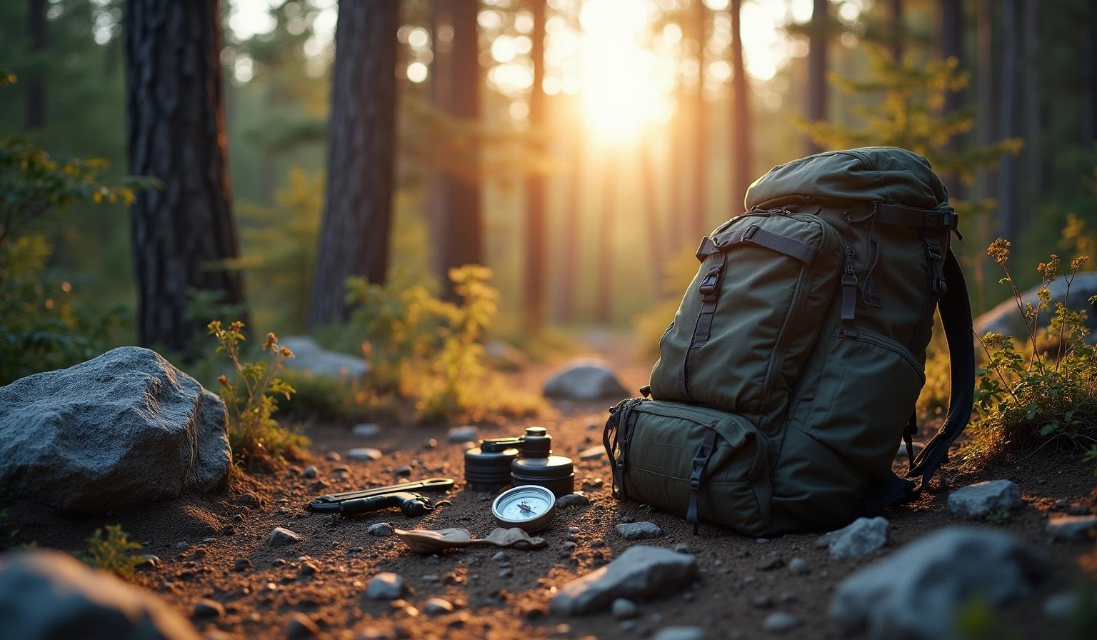






Practical guide for SIWA Start Course Director (SSCD)
SIWA START INSTRUCTOR
SURVIVAL COURSE
SIWA and its World Associations
are registered in
LLC LI 7000015171
State of Florida at Tallahassee
Survival Instructors World Associations Company

Slide 2
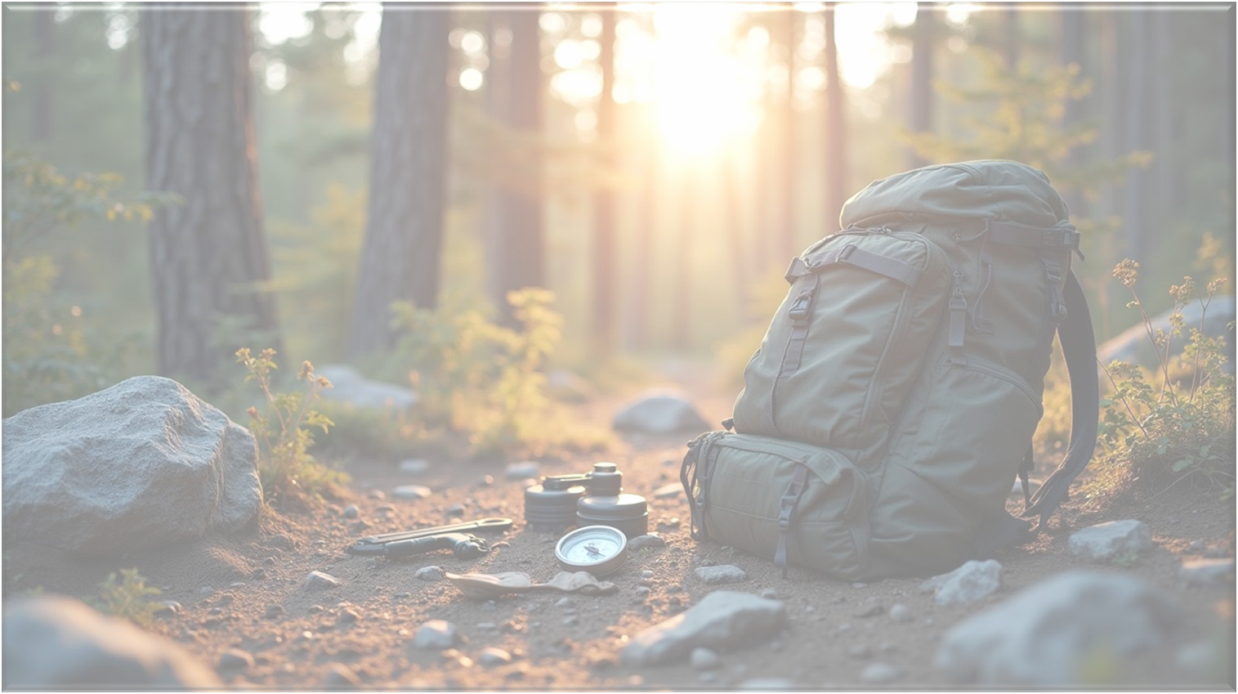


SIWA START INSTRUCTOR COURSE DIRECTOR (SSCD)
Program Summary
Skill 1. Role Assumption, Security Rings, Operational Discipline, and Leadership
Skill 2. First Aid, Natural Medicine & Tactical Medicine
Skill 3. Water: An Essential Element for Survival. Tactical Procedures
Skill 4. Fire: Generating Light & Heat for Survival. Tactical Procedures
Skill 5. Shelter: Building Mobile Housing, Defensive Structures, and Fortifications
Skill 6. Nutrition: Staying Healthy and Nourished for Survival. Concealing Evidence
Skill 7. Orientation by Maps, Positioning, Astronomy, and Clues. Maneuvering
Skill 8. Citizen Self-Defense, Operational Police Intervention & Military Hand-to-Hand Combat
Skill 9. Aquatic Survival, Maritime Search and Rescue
Detailed Program
Skill 1. Role Assumption, Security Rings, Operational Discipline, and Leadership
Skill 2. First Aid, Natural Medicine & Tactical Medicine
Skill 3. Water: An Essential Element for Survival. Tactical Procedures
Skill 4. Fire: Generating Light & Heat for Survival. Tactical Procedures
Skill 5. Shelter: Building Mobile Housing, Defensive Structures, and Fortifications
Skill 6. Nutrition: Staying Healthy and Nourished for Survival. Concealing Evidence
Skill 7. Orientation by Maps, Positioning, Astronomy, and Clues. Maneuvering
Skill 8. Citizen Self-Defense, Operational Police Intervention & Military Hand-to-Hand Combat
Skill 9. Aquatic Survival, Maritime Search and Rescue
Modifying any of its content is prohibited. If you wish to provide us with any suggestions, please send an email to-mail siwasurvival@gmail.com
This presentation is confidential, restricted to the scope of Instructors (SSCD) and may not be reproduced or disseminated outside of this scope.

Slide 3


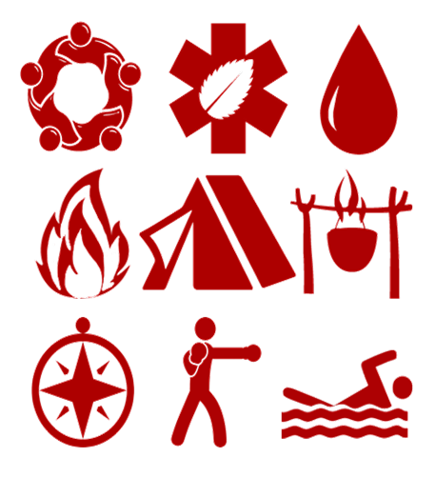
Contents & Procedures
These skills have names in two areas
The names of the Skills are:
– Nature & Primitive Survival, NS Nómada & Survival International School
– Extensions in the Technical-Tactical field, Technical & Tactical Survival: OW Okami Wander Technical & Tactical International School. Las denominaciones de los Skills son:
1. NS : Role Assumption & Security Rings
OW :Role Assumption, Security Rings, Operational Discipline & Leaders
2. NS : Emergency First Aid & Natural Medicine
OW : Emergency First Aid, Natural Medicine & Tactical Medicine
3. NS : Water. Essential Element for Survival
OW : Water. Essential Element for Survival. Tactical Procedures
4. NS : Fire. Generating Light & Heat for Survival
OW: Fire. Generating Light & Heat for Survival. Tactical Procedures
5. NS : Shelter. Building Mobile Housing
OW :Shelter. Building Mobile Housing, Structures
6. NS : Nutrition. Staying Healthy and Nourished to Survive
OW :Nutrition. Staying Healthy and Nourished to Survive. Concealing Evidence
7. NS : Orientation by Maps, Positional Astronomy, and Evidence
OW :Orientation by Maps, Positional Astronomy, and Evidence. Maneuvering
8. NS : Citizen Self-Defense
OW : Citizen Self-Defense, Operational Police Intervention & Military Hand-to-Hand Combat
9. NS : Aquatic Survival
OW : Aquatic Survival, Maritime & Fresh Search and Rescue

Slide 4
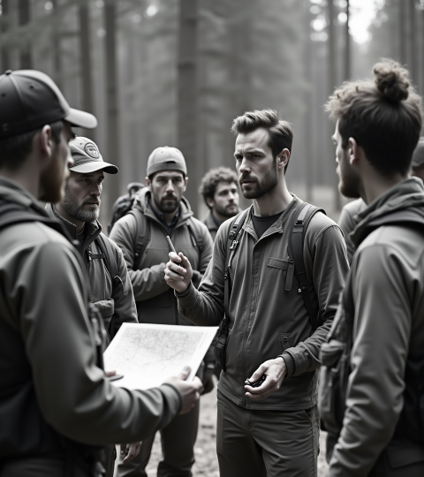
Contents & Procedures
The training is structured as follows:
– In-person training, which includes practical exercises, workshops, and other activities designed to achieve the appropriate level of skill and proficiency
– Distance learning, which complements the in-person training
– Blended learning. Due to its effectiveness, this model will be the most common. All Levels courses fall under this category. However, the in-person and distance learning modalities are complementary, facilitating continuous training over time. They ARE ALSO INDEPENT, allowing you to take only the in-person courses, only the distance learning courses, or both
Nevertheless, successful completion of both the in-person and distance learning modalities is required to obtain the SIWA Start Instructor Certification
* In addition, there are specific syllabi included and not included in this index for professional sectors (security, armed forces and other professionals exposed to specific risks) where there are special conditions that only affect them and which include special and restricted training for these groups

Slide 5

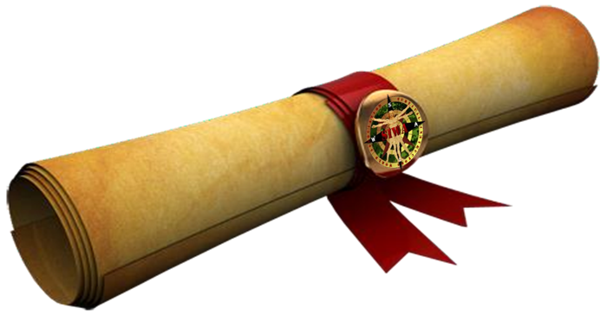


Summary Program
To analyze them in greater depth, you must access the Detailed Program. The names of each Skill are included in both the Nomad Program (in red) and the Okami Wander Program (in black)
* In all Skills except Skill 8 Citizen Self-Defense, the in-person course consists of putting all or part of the content of the online course into practice. Skill 8 has a different structure, and the in-person course includes much content not covered in the online course
NOMADA
OKAMI WANDER

Slide 6


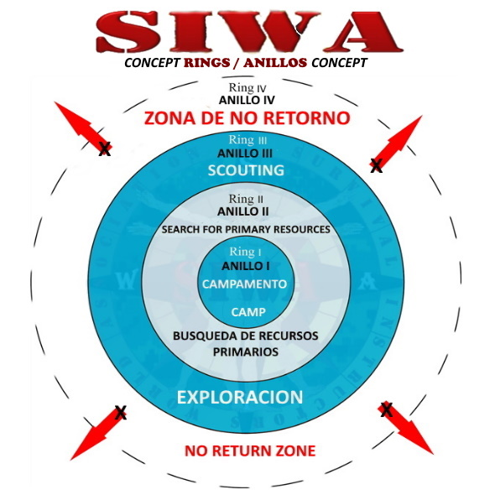
Assumption of Roles & Security Rings
Assumption of Roles & Security Rings, Operational Discipline & Leadership
Team organization and survival
1. Situation Assessment and Action Protocol
1.1. Actual Survival and Controlled Survival
1.2. PAS Action Protocol (Protect, Alert, Assist)
1.3. Situation Assessment, Threats, and Resources
2. Psychology of Survival and Roles
2.1. Managing Stress, Fear, Panic, and Loneliness
2.2. Roles in Survival Situations
2.3. Appointing a Leader and Their Responsibilities
3. Intelligence as a Tool
3.1. Tools for Developing Survival Skills
4. Security Rings4.1. Ring 1: Base Camp
4.2. Ring 2: Searching for Primary Resources
4.3. Ring 3: Exploration
4.4. Ring 4: Terrain Outside Ring 3

Slide 7


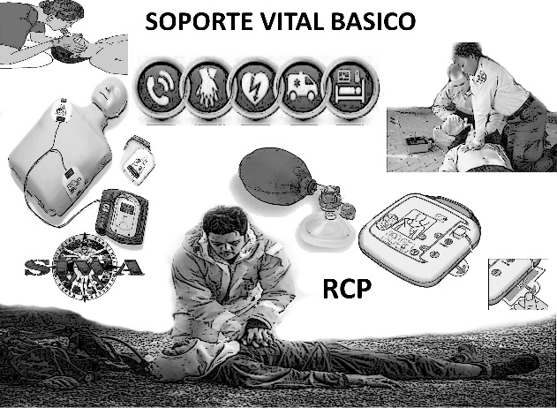
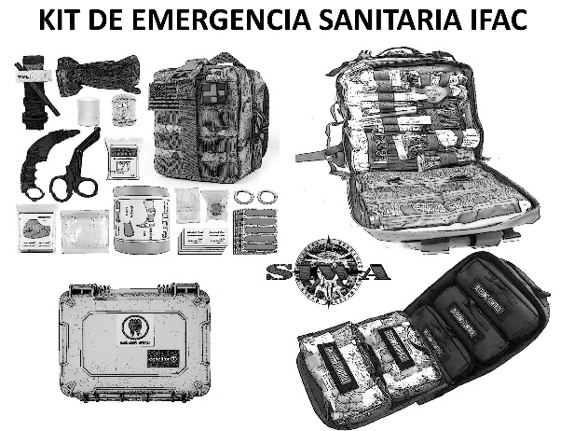
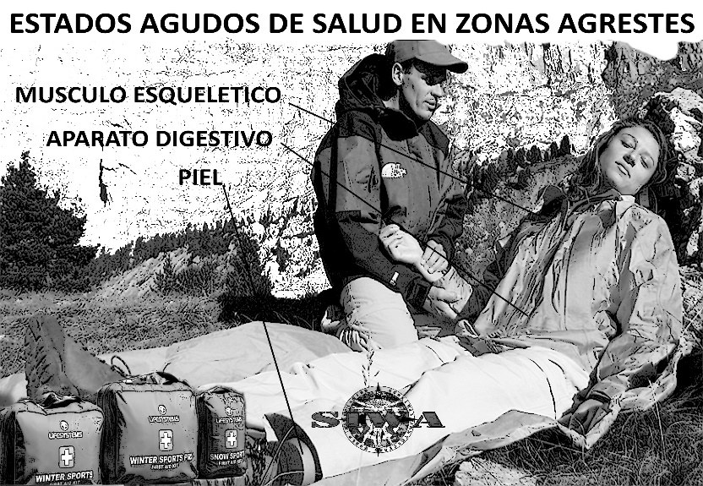
First Aid & Natural Medicine
First Aid, Natural Medicine and Tactical Medicine
preserving health to survive
1. Interventional Medicine, Action Guidelines
1.1. Initial Patient Assessment
1.2. Cardiopulmonary Resuscitation
1.3. Hemorrhage and Shock
1.4. Wounds and Bruises
1.5. Burns and Frostbite
1.6. Musculoskeletal Injuries
1.7. Other Emergency Situations
1.8. Pregnancy Emergencies
1.9. The First Aid Kit
2. The Survival Kit: Distress and Emergency
Signals (Basic Air and Sea Signals)

Slide 8


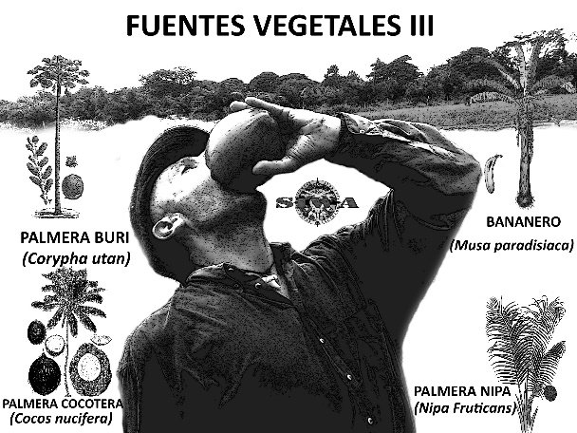
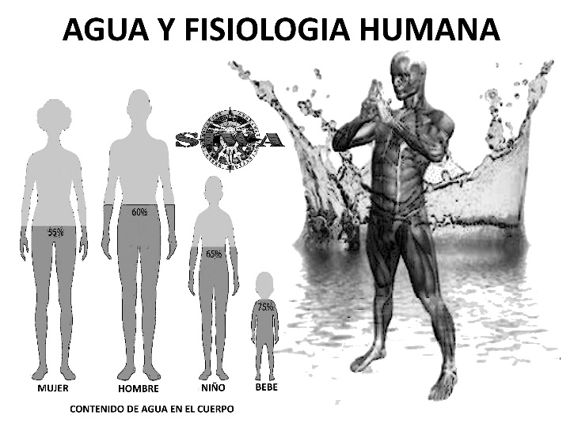
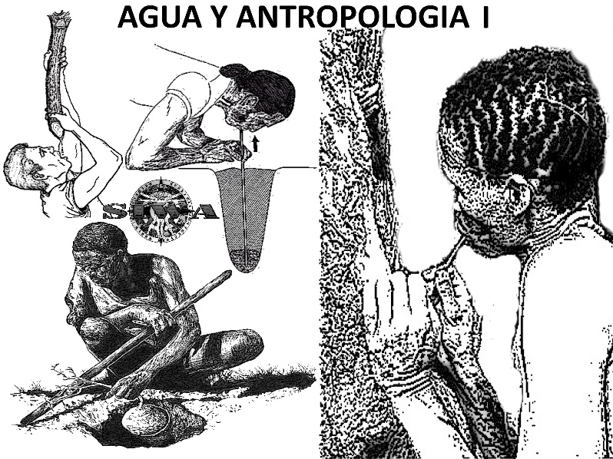
Water. An Essential Element for Survival
Water. An Essential Element for Survival, Tactical Procedures
the channel of life
Introduction
1.1. Water and Survival
1.2. Water Collection Systems
1.3. Other Systems
2. Water Processing
2.1. Distinguishing Between Bacteriological
and Chemical Contamination
2.2. Filtration
2.3. Purification

Slide 9


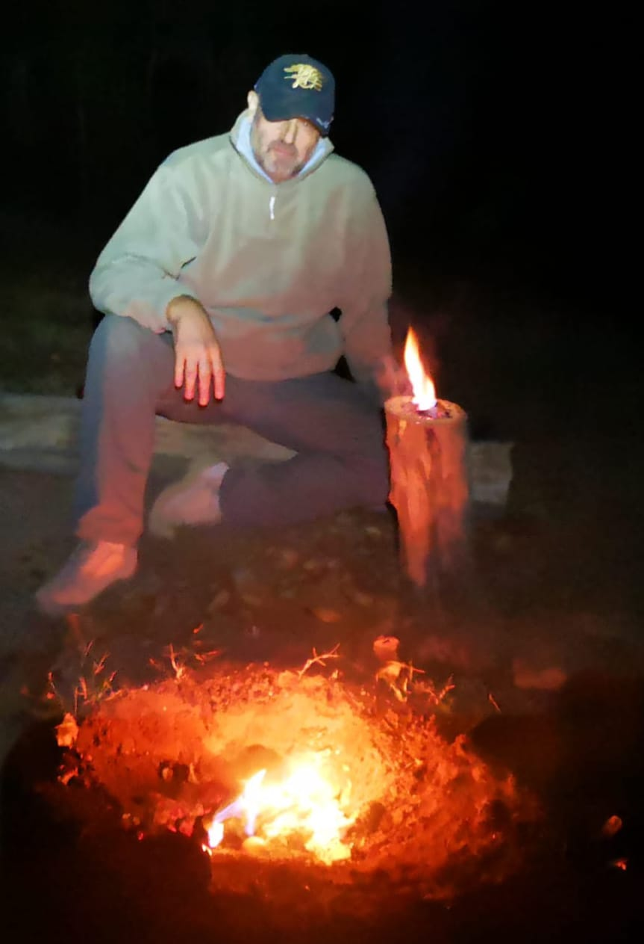
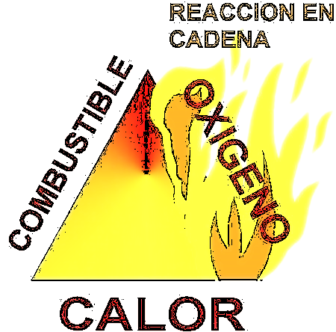
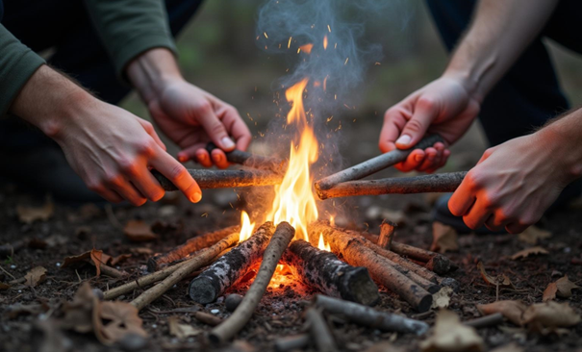
Fire. Generating Light & Heat to Survive
Fire. Generating Light & Heat for Survival. Tactical Procedures
the most important energy in human evolution
1. Technical Definition
2. The Scalability of Fire
2.1. Types of Tinder and How to Produce Them
2.2. Carbonization
3. Methods of Making Fire
3.1. Fire by Friction
3.2. Fire with Lenses
3.3. Fire with a Cotton Roller and Ash
3.4. Fire with Ferrocerium
3.5. Fire with Flint and a Link

Slide 10


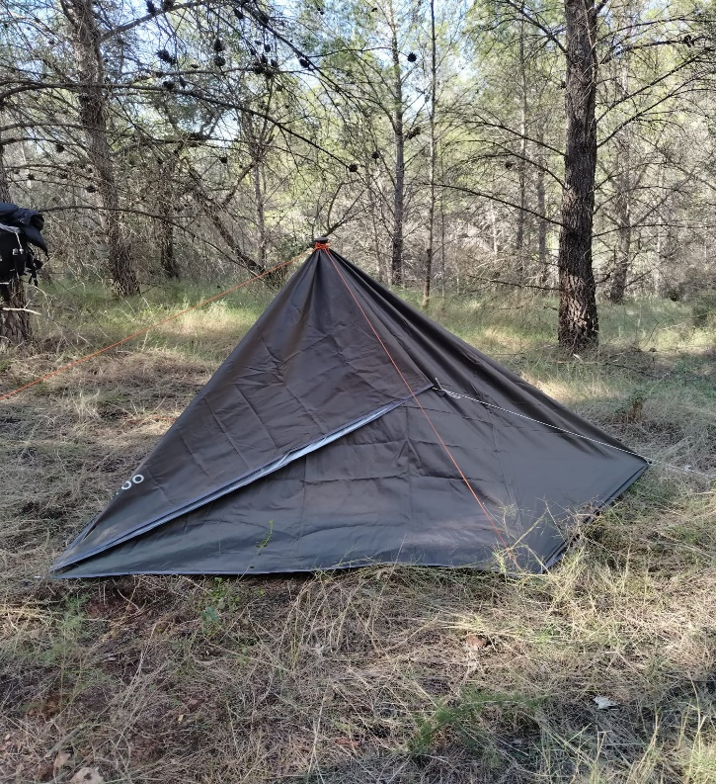
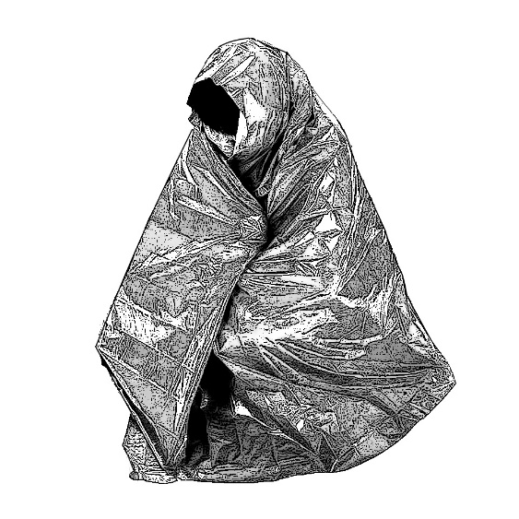
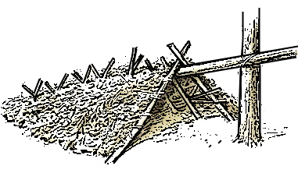
Shelter. Building the mobile home
Shelter. Building the mobile dwelling, Defensive structures & Fortifications
the protection and shelter necessary
1. The thermal blanket
2. Importance of shelter
2.1. Factors to consider in its construction
2.2. Types according to the environment
2.3. Knotting workshop
3. Shelters built with vegetation
4. Shelters built with stones
5. Excavated shelters
6. Natural shelters: caves, rock shelters, and hollows
7. Synthetic shelters with tarpaulin, groundsheet, or poncho

Slide 11


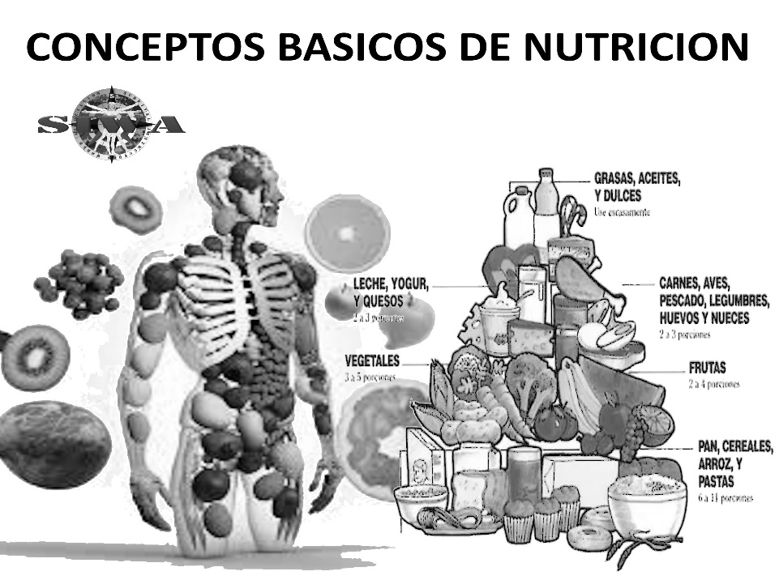
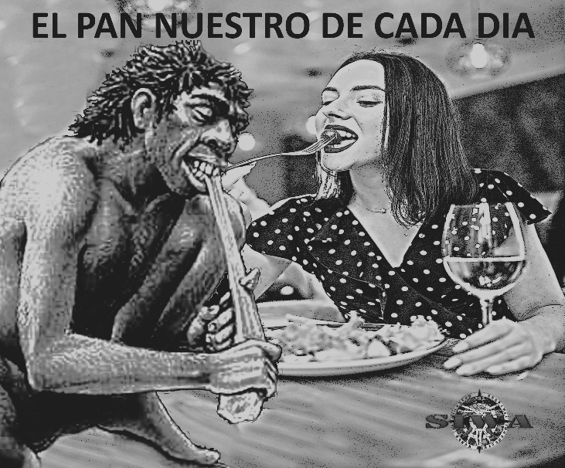
Nutrition. Staying Healthy & Nourished to Survive
Nutrition. Staying Healthy & Nourished to Survive, Hiding Evidence
the energy of life
1. Introduction
2. Plant-Based Foods
2.1. Edibility Test
2.2. Poisonous, Toxic, and Psychotropic Plants
3. Animal-Based Foods
3.1. Hunting (minimum 2 methods)
3.2. Fishing (minimum 2 methods)

Slide 12


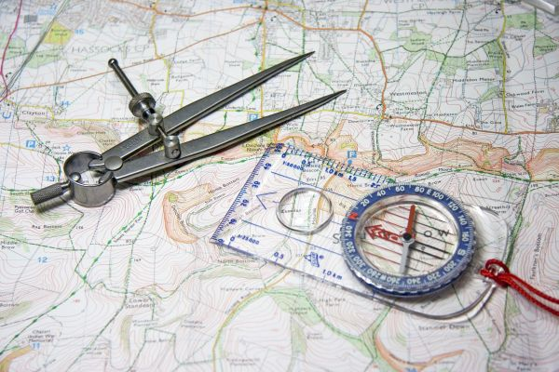

Orientation by Cartography, Position, Astronomical Clues
Orientation by Cartography, Position, Astronomical Indications. Maneuver
where, by which way, how and when
1. Representation of the Earth, Projections
1.1. The Map
1.2. Scale and Distance Calculation
1.3. UTM Coordinates
1.4. Geographic Coordinates
1.5. Contour Lines
1.6. The Compass
1.7. Basic Techniques for Interpreting a Map
1.8. Orientation by Natural Landmarks
1.9. Basic Orientation by Stars
1.10. Route Planning with the Map, the Topographic Itinerary
1.11. Triangulation
1.12. Communications. Satellite Devices

Slide 13


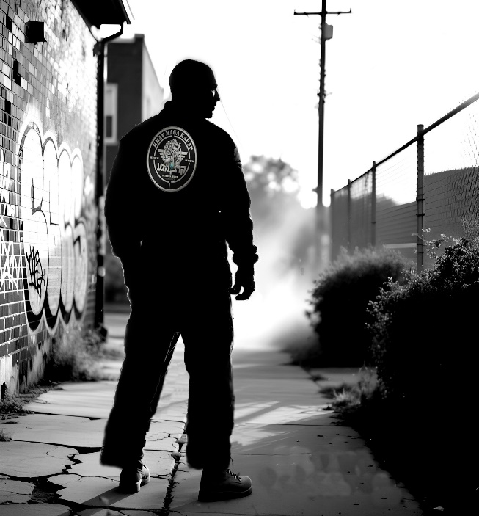
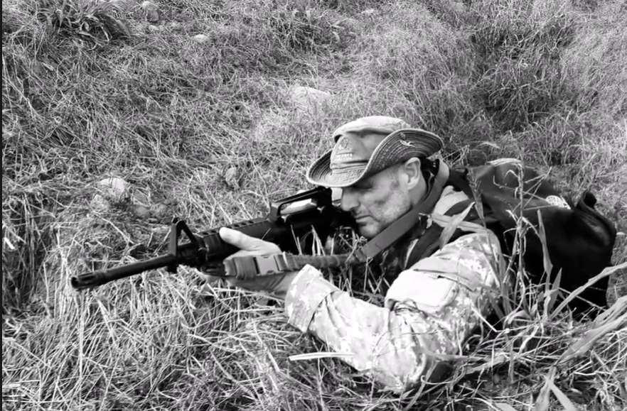
Citizen Self-Defense
Citizen Self-Defense, Operational Police Intervention, Military Hand-to-Hand Combat
survival against human enemies
THEORETICAL COURSE
1. Introduction
2. Combat Sports VS. Professional and
Realistic Combat Systems
3. Analyzing the Situation
4. Pyramid of the Use of Force
5. PNF Combat Scheme (Protection,
Neutralization, Termination)
6. Tactical Principles of Engagement
7. Self-Defense
8. Safety Regulations
IN-PERSON COURSE
Introduction
2. Brief review of theoretical content
3. Safety regulations
4. The primary objective of survival
5. Combat zones and distances
6. Guard duty
* Common elective content for civilians, military personnel and security professionals only for OW SIWA Start Course Director (SSDC)

Slide 14


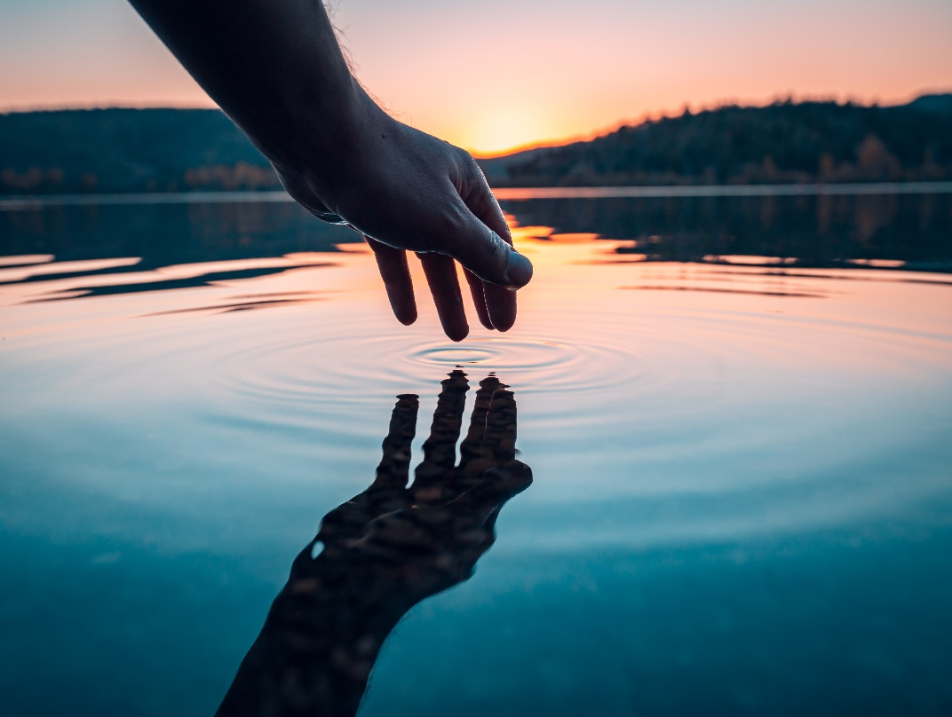
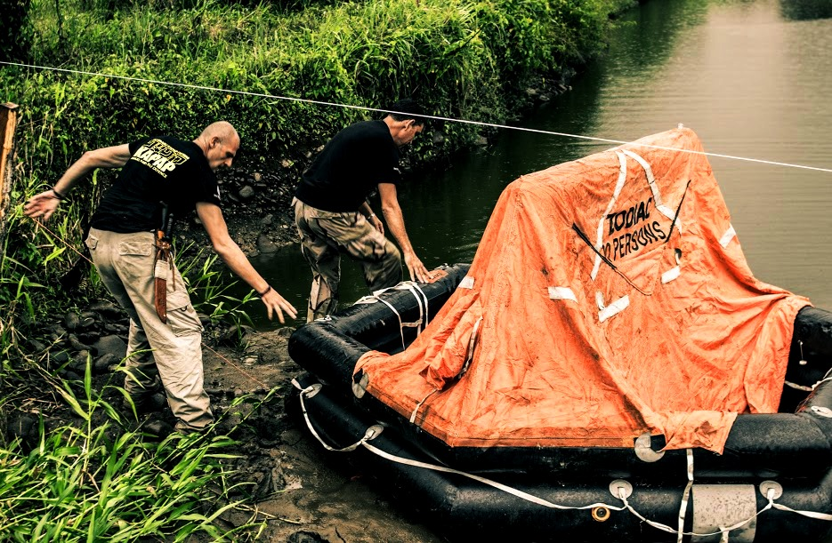
Aquatic Survival
Aquatic Survival, Maritime Search & Rescue
adaptation to all aquatic environments
1. Aquatic Survival
2. Aquatic Environment
3. Environmental Assessment
4. Recognizing Our Capabilities
5. Survival Swimming Techniques
6. Survival Buoyancy Techniques
7. Basic Freediving Techniques
8. Basic Escape Techniques
9. Basic Water Entry Techniques
10. Shipwrecked Person Behavior in the Water

Slide 15
Detailed Program
This section includes the more developed content, so that it can be analyzed in greater detail
* In all Skills except Skill 8 Citizen Self-Defense, the in-person course consists of the practical application of all or part of the content from the online course. Skill 8 has a different structure, and the in-person course includes much content not covered in the online course
NOMADA
OKAMI WANDER

Slide 16
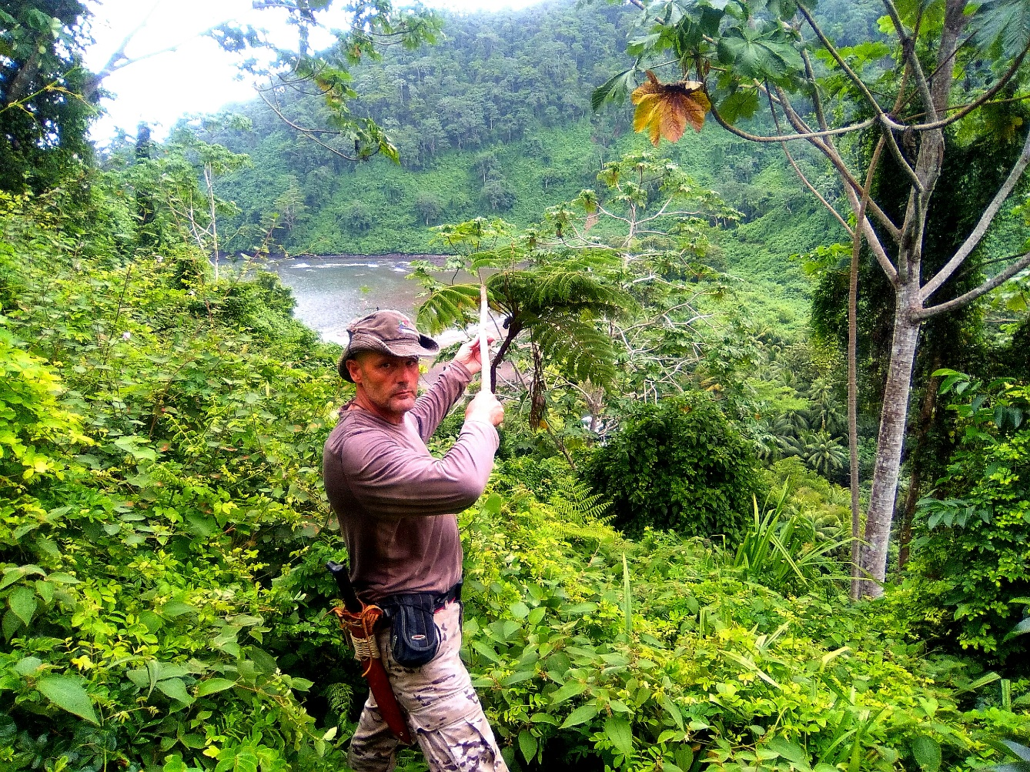
I
Assumption of Roles & Security Rings
Assumption of Roles, Security Rings, Operational Discipline & Leadership
team organization and survival
5.4.Temperate Forest
5.5. Glacial or High Mountain
5.6. Sea
5.7. Coast
6. Disasters
6.1. Natural
6.2. Socio-natural
6.3. Anthropogenic; Hostile Environment, Conflict Zones
7. Life-Threatening Factors, the Rule of Three
8. The Survival Mindset
9. Air
10. Cold, Hypothermia
11. Water
12. Food
13. Resources for Life
13.1. Tangible; Recover, Reuse, Recycle
13.2. The Purpose (Why) of Things
13.3. Intangible, People
1. Situation Assessment, Action Protocol
1.1. Actual Survival and Controlled Survival
1.2. Survival in Controlled Environments
1.3. For Training
1.4. As an Adventure Activity
1.5. True Survival
2. Cases Leading to a Survival Situation
2.1. Accidents
2.2. Natural Disasters
2.3. Losses
2.4. Human Conflicts
3. PAS Action Protocol (Protect, Alert, Assist)
4. Situation Assessment, Threats, and Resources
5. Types of Environments
5.1. Arid or Semi-desert
5.2. Tropical Rainforest
5.3. Dry Forest

Slide 17

II
Assumption of Roles & Security Rings
Assumption of Roles, Security Rings, Operational Discipline & Leadership
team organization and survival
1. Psychology of Survival, Roles
1.2 Managing Stress, Fear, Panic, and Loneliness
1.3. Foundations of Emotional Intelligence (EI)
1.4. Roles in Survival Situations
2. Appointing a Leader and Their Responsibilities
2.1. The Leader's Mission
2.2. The Leader Appointment System
2.3. Tasks Assigned by the Leader
3. Appointing Supervisors and Middle Managers
4. Intelligence as a Tool
5. Tools for Developing the Ability to Survive
6. Deductive Reasoning
6.1. Inductive Reasoning
7. Security Rings
7.1. Ring 1, Base Camp
7.2. First task: clearing and cleaning the living area
7.3. Construction of the bivouac shelter
7.4. Construction of a permanent fire system and
a firewood storage protected from the rain
7.5. Construction of an elevated pantry
7.6. Construction of latrines
7.7. Potable water storage and purification systems
7.8. Demarcation and possible alarm and/or defensive systems against attacks by dangerous animals
7.9. Workshop and miscellaneous work are

Slide 18
III
Assumption of Roles & Security Rings
Assumption of Roles, Security Rings, Operational Discipline & Leadership
team organization and survival
8. Ring 2. Primary Resource Search
8.1. Auditory or Visual Communication
8.2. Smoke Alert Systems and Protocol Designation
8.3. Timber, Food, and Water Zone
8.4. Safety Protocols for Resource Searching
8.5. Expanding Ring 2 through the Application of Communication Protocols
8.6. Trail and Signage Network
9. Ring 3 Exploration
9.1.The Risk of Isolation
9.2. Return Methods
9.3. Searching for New Settlements and Resources
9.4. Long-Distance Trail and Signpost Network
10. Ring 4 Terrain Outside Ring 3
10.1. Preparing to Leave Base Camp
10.2. Reorganizing the Traveling Group

Slide 19
I
First Aid & Natural Medicine
First Aid, Natural Medicine & Tactical Medicine
preserving health to survive
1. Interventional Medicine: Guidelines for Action
1.1. Initial Patient Assessment
1.2. Action Plan
1.3. Primary and Secondary Assessment
2. Cardiopulmonary Resuscitation (CPR)
2.1. Causes of Cardiac Arrest (CA)
2.2. CPR in Adults
2.3. CPR in Children
3. Airway Obstruction in Adults
3.1. Airway Obstruction in Children and Infants
4. Hemorrhage and Shock
4.1. Concepts and Classification
4.2. Guidelines for Action in Cases of External Bleeding
4.3. Guidelines for Action in Cases of External Bleeding
4.4. Guidelines for Action in Cases of Internal Bleeding
5. Shock
6. Wounds and Contusions
6.1. Wounds
6.2. Contusions
7. Burns and Frostbite
7.1. Burns
7.2. Frostbite

Slide 20
II
First Aid & Natural Medicine
First Aid, Natural Medicine & Tactical Medicine
preserving health to survive
9. Other Emergency Situations
9.1. Fainting
9.2. Heart Attack
9.3. Seizure
9.4. Heatstroke
9.5. Dehydration
9.6. Hypoglycemia
9.7. Panic Attack
9.8. Stings and Bites
10. Pregnancy Emergencies
11. The IFAK First Aid Kit
12. The Survival Kit
8. Musculoskeletal Injuries
8.1. Sprain
8.2. Dislocation
8.3. Fracture
8.4. Muscle Strain
8.5. Head and Spinal Injuries
8.6. Polytrauma

Slide 21
I
Water. An Essential Element for Survival
Water. An Essential Element for Survival, Tactical Procedures
the channel of life
1. Introduction
1.1. Water and Survival
1.2. Water Collection Systems
1.3. Digging a Hole in a Slope to Collect Rainwater
1.4. Collecting Rainwater with an Emergency Poncho or Plastic Sheet
1.5. Collecting Dew by Covering a Hole with Plastic Sheeting (Distiller)
1.6. Digging in Natural Wet Springs or Puddles to Reach the Water Table
1.7. Inside Caves and Mines
1.8. Dig a well a few meters from the shoreline. The water obtained can be sipped using our survival tube
1.9. Ice and snow
1.10. Water trap to take advantage of the sharp temperature changes between day and night
1.11. Collector of water released through plant evapotranspiration
1.12. Water collector on riverbanks
1.13. Water-storing plants
1.14. Other systems

Slide 22
II
Water. An Essential Element for Survival
Water. An Essential Element for Survival, Tactical Procedures
the channel of life
1. Water Treatment Procedures
1.1 How to Distinguish Between Bacteriological
and Chemical Contamination
2. Filtration
2.1 By Decantation
2.2 Using Filters
3. Purification
3.1 From Possible Bacteriological Contamination
3.2 Boiling
3.3 Using Purification Tablets
3.4 Using Bleach
3.5. With iodine
3.6. By exposure to UV light from the sun or UV-electric light
4. From possible chemical contamination
4.1. Carbon filter (partial)
4.2. Reverse osmosis
5. Desalination
5.1. Desalination by capillary action
5.2. By condensation
6. Obtaining potable water contained in plants.

Slide 23
Fire. Generating Light & Heat to Survive
Fire. Generating Light & Heat to Survive, Tactical Procedures
the most important energy in human evolution
1.Technical Definition
2.1. The Scalability of Fire
3.1. Types of Wood
3.2. Types of Tinder and How to Produce Them
3.3. Carbonization
4. Methods of Making Fire
4.1. Fire by Friction (Egyptian Bow, Saw, etc.)
4.2. Fire Using Lenses
4.3. Fire Using a Cotton and Ash Roller
4.4. Fire Using Ferrocerium
4.5. Fire with flint and flint
4.6. Fire with water (acetylene)
4.7. Fire by adiabatic pressure (fire piston)
4.8. Electric fire with battery and aluminum foil
4.9. Electric fire with battery and steel filaments (voltaic arc)
4.10. Chemical fire by friction of potassium permanganate and sugar (redox reaction)
5. Types of bonfires
6. Processing wood for bonfires (firewood)
7. Chemical starters (hydrocarbons, paraffins, etc.)

Slide 24
Shelter. Building Mobile Housing
Shelter. Building Mobile Housing, Defensive Structures & Fortifications
the necessary protection and shelter
1. The thermal blanket
2. Importance of shelter
2.1. Factors to consider in its construction
3. Types according to the environment
3.1. Shelters built with vegetation
3.2. Shelters built with stones
3.3. Excavated shelters
3.4 Natural shelters: caves, rock shelters, and hollows
3.5 Shelters with tarpaulins, groundsheets, or ponchos
4. Knot Workshop
4.1. Workshop on Fibers, Fabrics, and Ropes, etc.
4.2. Esparto Grass
4.3. 3-Strand Braiding
4.4. 4-Strand Round Braiding
4.5. 5, 7, and 9-Strand Pleats
4.6. Wicker
4.7. Reeds and Bamboo
4.8. Reed Weaving and Interlacing
4.9. Agave or Pita
4.10. Making Pita Rope
4.11. Other Natural Fibers

Slide 25
Nutrition. Staying Healthy & Nourished to Survive
Nutrition. Staying Healthy and Nourished to Survive, Hiding Evidence
the energy of the life
1. Introduction
1.2. Plant-Based Foods
1.3. Edibility Test
1.4. Poisonous, Toxic, and Psychotropic Plants
2. Animal-Based Foods
2.1. Hunting (Minimum of 2 Methods)
2.2. Fishing (Minimum of 2 Methods)
3. Food Preservation
3.1. Methods for Preserving Vegetables
3.2. Methods for Preserving Meat or Fish
3.3. Drying or Dehydration
3.4. Drying
3.5. Cooking and Blanching
3.6. Smoke Drying
3.7. Smoke Drying
3.8. Salting
3.9. Pickling, Marinating and Preserving
3.10. Freezing
3.11. Preserving in Syrup
3.12. Sterilization
3.13. Vacuum Packing

Slide 26
Orientation by Cartography, Positioning, Astronomy and Signs
Orientation by Cartography, Positioning, Astronomy, Signs & Maneuver
where, by which way, how and when
1. Representation of the Earth, Projections
1.1. The Map
1.2. Scale and Distance Calculation
1.3. UTM Coordinates
1.4. Geographic Coordinates
1.5. Contour Lines
1.6. The Compass
1.7. Basic Techniques for Interpreting a Map
1.8. Orientation by Natural Landmarks
1.9. Basic Orientation by Stars
1.10. Route Planning with the Map, the Topographic
Itinerary
1.11. Triangulation
1.12. Communications. Satellite Devices
2. Positional Astronomy
2.1. Our Location on the Planet
2.2. The Tropics
2.3. The Polar Circles
2.4. The Solstices and Equinoxes, the Seasons
2.5. Orientation by the Stars
2.6. Orientation by the Sun
2.7. Orientation by the Moon
2.8. Other Ways of Orienting

Slide 27
I
Citizen Self-Defense
Self-Defense, Operational Police Intervention & Military Hand-to-Hand Combat
survival against the human enemy
THEORETICAL COURSE
1. Introduction
2. Combat Sports VS. Professional and
Realistic Combat Systems
3. Analyzing the Situation
4. Pyramid of the Use of Force
5. PNF Combat Scheme (Protection, Neutralization,
Termination)
6.Tactical Principles of Engagement
7. Self-Defense8. Safety Regulations
IN-PERSON COURSE
1. Introduction
2. Brief review of theoretical content
3. Safety regulations
4. The primary objective of survival
* Common elective content for civilians, military personnel, and security professionals only for OW SIWA Start Course Director (SSCD)

Slide 28
II
Citizen Self-Defense
Self-Defense, Operational Police Intervention & Military Hand-to-Hand Combat
survival against the human enemy
IN-PERSON COURSE
5. Combat Zones and Distances
5.1. Red Zone
5.2. Green Zone
5.3. Contact Zone
6. Basic Techniques
6.1. Guard
6.2. Footwork
6.3. Strikes
6.4. Blocks
6.5. Falls
6.6. Takedowns
6.7. Joint Locks
7. Procedures
7.1. Defenses Against Grabs
7.2. Elements of Fortune
8. Covert Actions
8.1. Secrecy and Surprise as Tactical Elements
8.2. Deception During the Confrontation
* Common elective content for civilians, military personnel, and security professionals only for OW SIWA Start Course Director (SSCD)

Slide 29
Aquatic survival
Aquatic Survival, Maritime Ramson & Rescue
adaptation to all aquatic environments
1.Aquatic Survival
2. Aquatic Environment
3. Environmental Assessment
4. Recognizing Our Capabilities
5. Specific Environmental Assessment
6. Applying Our Capabilities
6.1. Basic Survival Swimming Techniques
6.2. Basic Buoyancy Techniques for Survival
6.3. Basic Apnea Techniques
6.4. Basic Freeing Techniques
6.5. Basic Water Entry Techniques
6.6. Basic Water Exit Techniques
6.7. Basic Drills in a Shipwreck Situation
* Common content of free designation for SIWA Start Course Director (SSCD) specialized instructors

Slide 30
GUIDE FOR CREATING AN EMERGENCY PLAN I
ORGANIZATIONAL STRUCTURE OF THE PLAN
3. Local Emergency Committee
3.1 Plan Director: Mayor Operational
3.2. Coordination: Local Police, Civil Protection
and Fire Department
3.3. Technical Support: Engineers, geographers, meteorologists, and healthcare professionals
3.4. Citizen Collaboration: Neighborhood associations
and trained volunteers
3.5. Activation Levels
Level 0: Locally controllable situations, without serious impact
Level 1: Emergencies requiring regional coordination
Level 2: Serious emergencies requiring state intervention
OBJECTIVES
1.To protect the population, property, environment
and heritage from emergencies
1.2. To guarantee a coordinated and effective
response to critical situations
1.3. To minimize the consequences of disasters through
prevention and preparedness
RISK ANALYSIS
2. Risk Identification
2.1. Natural Risks: Floods:
Due to proximity to the dry river and coastal areas
Forest fires: Especially inland and peri-urban areas
Adverse weather phenomena: Storms with rain, wind
or extreme heat
2.2. Technological Risks:
Urban or industrial fires
Chemical spills (in port or industrial areas)
Traffic accidents on main roads and railways
2.3. Anthropogenic Risks:
Social unrest, Terrorism or violent conflicts
* Content supervised by the SIWA Start Course Director (SSDC)

Slide 31
GUIDE FOR CREATING AN EMERGENCY PLAN II
COMMUNICATION AND ALERTS
4. Information Channels
4.1. Citizen Alert: Sirens, mass SMS, local radio,
social media, and digital billboards
4.2. Information Point: Municipal centers located
in each district
4.3. Communication with the Public
4.4. Be aware of awareness campaigns on risks
and preventive measures.
4.5. Obtain self-protection manuals distributed
to the public
SHELTERS AND SAFE ZONES
5.1. Sports centers, such as municipal pavilions,
educational centers, and private schools with
ample space.
5.2. Underground shelters in urban areas if the risk
is related to armed conflict.
PREVENTIVE MEASURES (Minimizing the
consequences of disasters through prevention
and preparedness)
1. Flood Risk Identification
1.2. Specific Evacuation Plans for risk zones
(low-lying areas, areas near rivers)
1.3. Meeting points and shelters such as sports
centers, health centers, and schools
1.4. Evacuation drills in risk zones
2. Forest Fires2.1. Identification of firebreaks and
evacuation routes2.2. Self-protection training for
residents of housing developments near forested areas
2.3. Increased vigilance during high-risk periods
3. Urban Risks
3.1. Evacuation routes for residential buildings
and workplaces, especially industrial areas
3.2. Safety protocols
* Content supervised by the SIWA Start Course Director (SSDC)

Slide 32
GUIDE FOR CREATING AN EMERGENCY PLAN III
EMERGENCY BACKPACKS AND SUPPLIES
6. 72-hour Emergency Backpack (per person)
6.1. Drinking water: 2 liters per day
6.2. Non-perishable food: energy bars and
canned goods6.3. Flashlight, batteries, and whistle
6.4. Thermal blankets and spare clothing
6.5. Personal documents and cash
6.6. If a secure storage area is available, extra fuel
for the vehicle
MONITORING AND CONTINUOUS IMPROVEMENT
7. Quarterly reviews of the plan and updating of
risk maps
7.1. Incident analysis to improve future protocols
7.2. Telecommunications are crucial for coordinating
actions and staying informed during emergencies
7.3. In case of a failure in conventional telephone
lines, it is vital to have alternative systems and
specific protocols
TELECOMMUNICATIONS IN EMERGENCY SITUATIONS
8. Identification of Associated Risks
8.1. Telephone network failure due to:
8.2 Natural phenomena: storms, floods, or
earthquakes
8.3. Network saturation: in case of a massive
Increase in calls
8.4. Infrastructure damage: fiber optic cable cuts or
affected communication towers
8.5. Cyberattacks that disrupt digital services and
networks
9. Alternative Solutions in Case of Failure
9.1 Radio Frequency Networks:
9.2. Use of VHF/UHF portable radios for communication between emergency teams
9.3. Collaboration with organized amateur radio
operators, such as the National Emergency
Radio Network (REMER)
9.4. Knowledge of the location of repeaters in the are
a to extend coverage in affected zones
* Content supervised by the SIWA Start Course Director (SSDC)

Slide 33
GUIDE FOR CREATING AN EMERGENCY PLAN IV
9.5. Satellite Telephony: Satellite telephony
devices for authorities and plan coordinators
Benefits: independence from terrestrial infrastructure
and global coverage
9.6. Satellite Internet:
9.7. Satellite internet terminals (e.g., Starlink)
to maintain access to digital communications and data
(only work with clear skies)
9.8. Communications Drones:
Inquire, if possible, about
the use of drones with repeaters to restore temporary
communications in critical areas
9.9. Mesh Systems:
9.10. Decentralized networks created with mobile devices
or specific routers to connect response teams
9.11. Manual and Conventional Messaging:
Ultimately, rely on human messengers to transport critical
information between strategic points.
10. Knowledge of Existing Information Channels for
the Population
10.1 Local and National
Radio: Official information via radio stations
10.2 Recommendation of portable radios with batteries
or dynamos
10.3 Loudspeakers and Public Address Systems:
10.4 Vehicles equipped with loudspeakers to broadcast instructions in affected areas11. Visual Signaling:
11.1. Use of flags, lights, or luminous signals at
critical points to communicate emergency situations or evacuation routes
12. Physical Information Points:
12.1. Municipal centers as meeting points and distribution points for printed information (posters or flyers).
* Content supervised by the SIWA Start Course Director (SSDC)

Slide 34
GUIDE FOR CREATING AN EMERGENCY PLAN V
RECOMMENDED TELECOMMUNICATIONS EQUIPMENT
13. Information on the availability to Authorities and Emergency Services of high-power two-way radios (VHF/UHF) with a range of 10 km or more
13.1. Information on the availability to Authorities and Emergency Services of weatherproof satellite phones
13.2. Information on the availability to Authorities and Emergency Services of drones with signal repeaters and cameras for remote assessment
13.3. Portable MESH network servers for temporary data coverage
13.2. It is recommended to have AM/FM radios with long-life batteries or solar-powered rechargeable batteries
13.3. It is recommended to have offline applications, such as FireChat (personal MESH networks)
13.4. It is recommended to have mobile phones with external batteries and SMS messaging capabilities in case of low connectivity
TRAINING AND DRILLS
14. Emergency training in the use of radio and satellite
Equipment
14.1. Participation in community workshops on the use
of emergency radios and the importance of remaining
calm in the event of a communication outage
14.2. Conducting specific drills to evaluate response times
and the effectiveness of alternative systems
* Content supervised by the SIWA Start Course Director (SSDC)

Slide 35
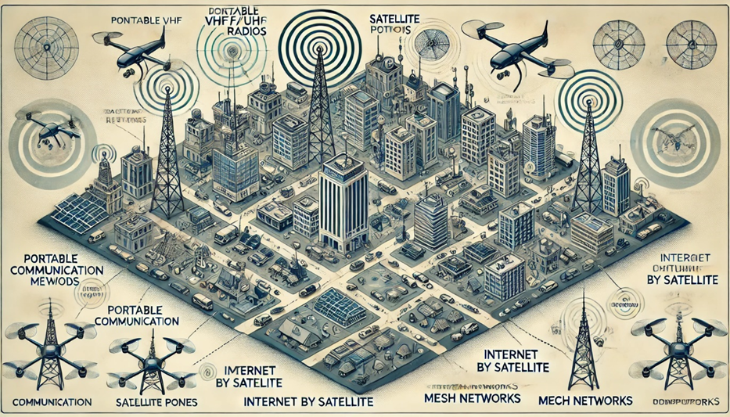
EQUIPOS
15. Este es el esquema visual que ilustra un plan de telecomunicaciones para emergencias en la ciudad. En el diagrama se incluyen diversos métodos de comunicación como radios VHF/UHF, teléfonos satelitales, redes MESH, internet por satélite y drones con repetidores de señal. También muestra cómo estos sistemas se interconectan para proporcionar comunicación confiable cuando las líneas telefónicas tradicionales fallan
GUIDE FOR CREATING AN EMERGENCY PLAN V
* Content supervised by the SIWA Start Course Director (SSCD)

Slide 36
GUIDE FOR CREATING AN EMERGENCY PLAN VI
SOCIAL MEDIA (SM)
16. Awareness of the existence of Institutional Profiles
on Social Media, such as emergency services, local institutions like the City Council, and Civil Protection agencies that have an active presence on platforms
like Facebook, Twitter, Instagram, and YouTube. Official profiles must be verified and easily accessible Recommended platforms:
16.1. X (formerly Twitter): Rapid announcements, alerts
and real-time monitoring
16.2. Facebook: More detailed posts, informational videos, and events
16.3. Instagram: For visual campaigns with
images and short videos that inform about the emergency plan16.4. YouTube: Publication of educational or
explanatory videos on how to act in emergencies
EMERGENCY PLAN UPDATE
17. Attention to Regular Publications and Updates
to the Emergency Plan
17.1 Informative Publications:
Weekly or monthly publications detailing the most
relevant aspects of the Emergency Plan (risk zones,
evacuation procedures, use of alternative means
of communication, etc.)
17.2. Consultation of new infographics and explanatory
videos to facilitate understanding of the procedures.
Infographics are highly shareable and easy to understand
17.3. Awareness Campaigns:
Hashtags: Create a specific hashtag for the plan
(e.g., #EmergencyPlan... or #Protection...)
This will make it easier for citizens to follow relevant
information about emergencies and participate in
conversations
17.4. Pay attention to the contests and challenges:
Participate through challenges such as “Do you know
how to evacuate your home in case of flooding?” or
“Post your emergency kit”
* Content supervised by the SIWA Start Course Director (SSCD)

Slide 37
GUIDE FOR CREATING AN EMERGENCY PLAN VII
17.5. Reminder Posts:
Remind people of the dates of drills or informational
events through posts and
events on Facebook or Instagram
17.6. Watch videos on YouTube or Instagram explaining,
for example, how the alert system works in your community
or how to use a satellite phone in case of emergency
INTERACTIVE AND PARTICIPATORY TOOLS
18. Surveys and Questionnaires
18.1. Watch surveys on Twitter or Facebook to assess
knowledge about the emergency plan
For example:
"Did you know how to act in case of a flood?“
18.2. Watch quizzes on Instagram Stories to learn
interactively, such as "What to do if there is an explosion
near your house?" and provide quick answers with links
to resources.
18.3. Live Streaming:
Attend live sessions on platforms like Instagram, Facebook, and YouTube to explain the Emergency Plan, answer questions, and explain how to prepare
for disasters. Streaming sessions may be scheduled on key dates or after an emergency drill
18.4. Live Chats and Rapid Response:
18.5. Monitor emergency chats on Facebook Messenger or WhatsApp where you can ask direct questions about the plan. Respond quickly to inquiries about evacuation, safe routes, shelters, and other relevant information.
* Content supervised by the SIWA Start Course Director (SSDC)

Slide 38
GUIDE FOR CREATING AN EMERGENCY PLAN VIII
REAL-TIME INFORMATION PUBLISHING DURING EMERGENCIES
19. When an emergency occurs (e.g., a flood, explosion, or fire), social media should be the primary channel for:
19.1. Emergency alerts: Use Twitter and Facebook to receive rapid alert messages such as “ALERT! A red alert has been issued for a storm in the northern part of… Avoid leaving your home.”
19.2 Use messages with hashtags such as #Emergency…or #FloodAlert…to maintain organized tracking of the crisis
19.3 Maps and locations:
19.4 Pay attention to posts of interactive maps or images of affected areas and evacuation points via Facebook and Twitter. On Instagram, you can post images and videos showing the status of affected areas and evacuation routes.
19.5. Information on shelter locations:
19.6. Pay attention to the publication of the addresses of shelters and emergency centers, such as designated schools and sports centers, with opening hours and directions
19.7. Contact information:
19.8. Know the emergency numbers and the availability of emergency services via WhatsApp or Facebook Messenger
COLLABORATION WITH INFLUENCERS AND MEDIA
20. Collaboration with local influencers:
20.1. Contact local influencers on platforms like Instagram or TikTok to promote the Emergency Plan, creating content that emphasizes the importance of being prepared. They can post about how to prepare an emergency kit, what to do in case of a flood, etc.
* Content supervised by the SIWA Start Course Director (SSCD)

Slide 39
GUIDE FOR CREATING AN EMERGENCY PLAN IX
20.2. Follow the media:
Follow local radio stations or television channels that broadcast information related to the Emergency Plan through their social media and live broadcasts
20.3. Follow interviews in local media with the Emergency Plan spokesperson and their explanations and actions to be taken in case of disasters
CONCLUSION
21. Reduced response times:
The plan optimizes the knowledge of existing emergency teams and available resources
21.1 Minimizing losses:
The emergency plan helps prevent material and human damage in case of a crisis (floods, explosions, fires, etc.)
21.2 Greater efficiency in the use of resources:
The plan makes more effective use of limited resources during an emergency (personnel, infrastructure, communication)
21.3. Preparedness and Resilience:
The plan involves us by ensuring you are informed and trained to act in emergencies, complying with regulations and standards aligned with local and international civil protection and public safety regulations
21.4. Ensuring Our Health:
Implementing the plan can prevent health problems (for example, during an explosion, flood, fire, etc.)
21.5. Improved Crisis Management:
The plan strengthens the capacity to manage complex crises and reduces the lack of appropriate action and coordination.
* Content supervised by the SIWA Start Course Director (SSCD)

Slide 40
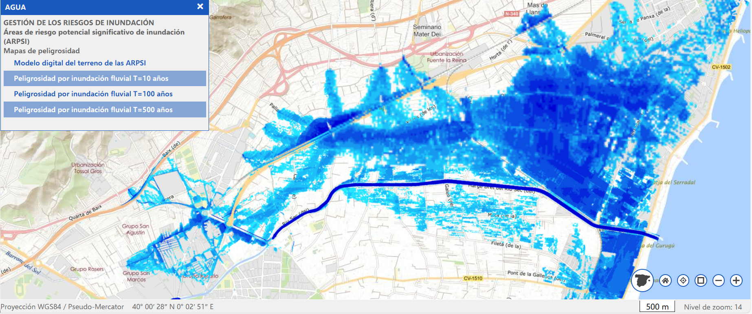
EXAMPLES OF INFOGRAPHICS ON FLOOD RISK I
RIVER FLOOD I
* Content supervised by the SIWA Start Course Director (SSCD)

Slide 41
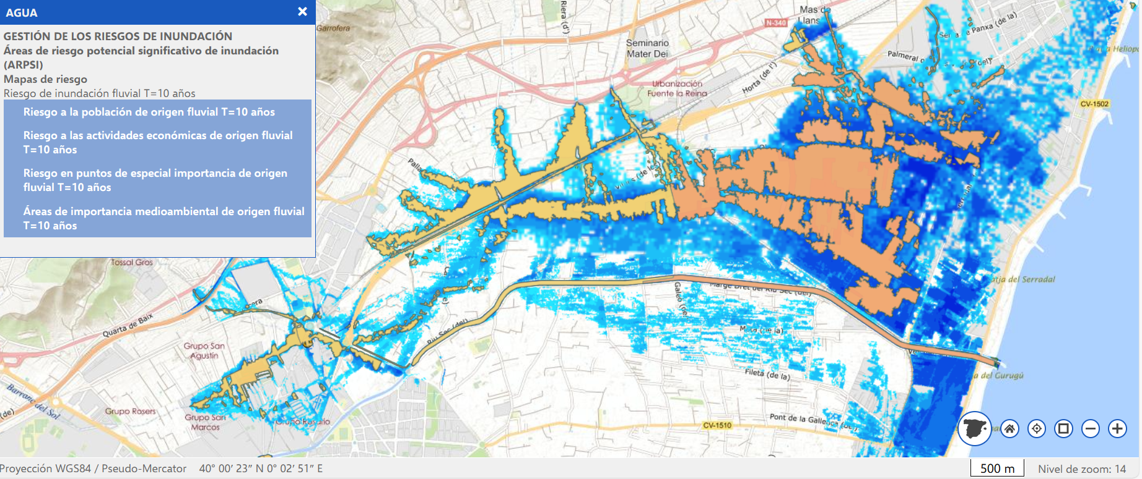
EXAMPLES OF INFOGRAPHICS ON FLOOD RISK II
RIVER FLOOD II
* Content supervised by the SIWA Start Course Director (SSCD)

Slide 42
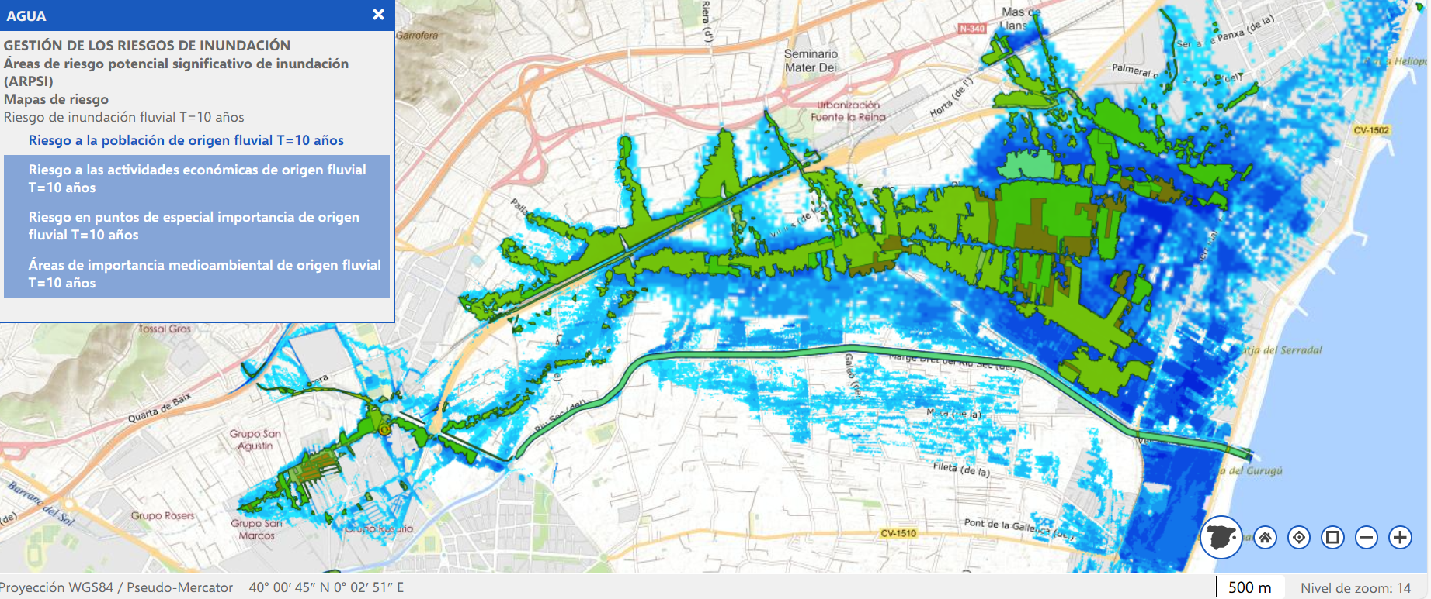
EXAMPLES OF INFOGRAPHICS ON FLOOD RISK III
RIVER FLOOD III
* Content supervised by the SIWA Start Course Director (SSCD)

Slide 43
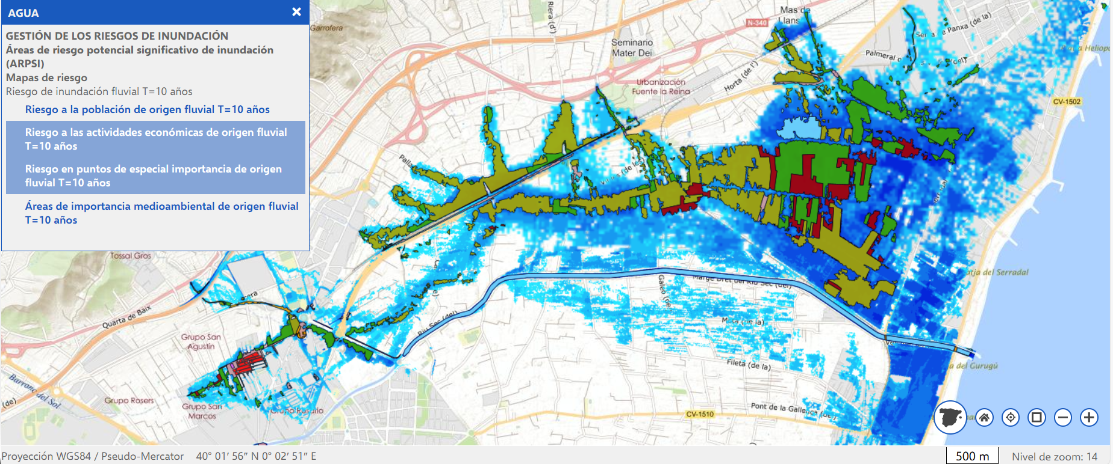
EXAMPLES OF INFOGRAPHICS ON FLOOD RISK IV
RIVER FLOOD IV
* Content supervised by the SIWA Start Course Director (SSCD)

Slide 44
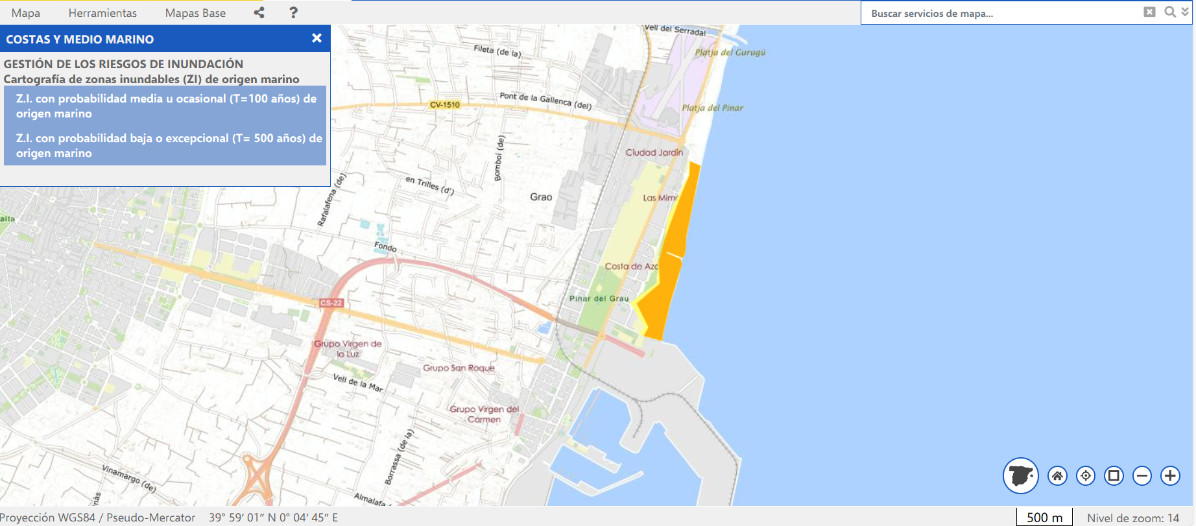
EXAMPLES OF INFOGRAPHICS ON FLOOD RISK V
MARINE FLOOD
* Content supervised by the SIWA Start Course Director (SSCD)

Slide 45
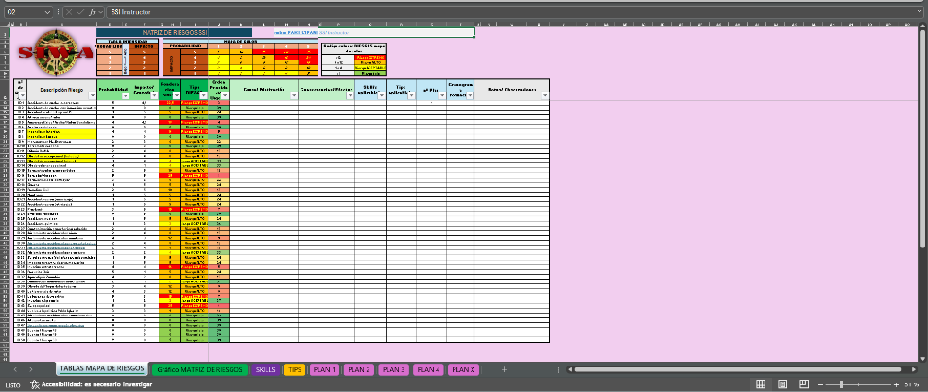
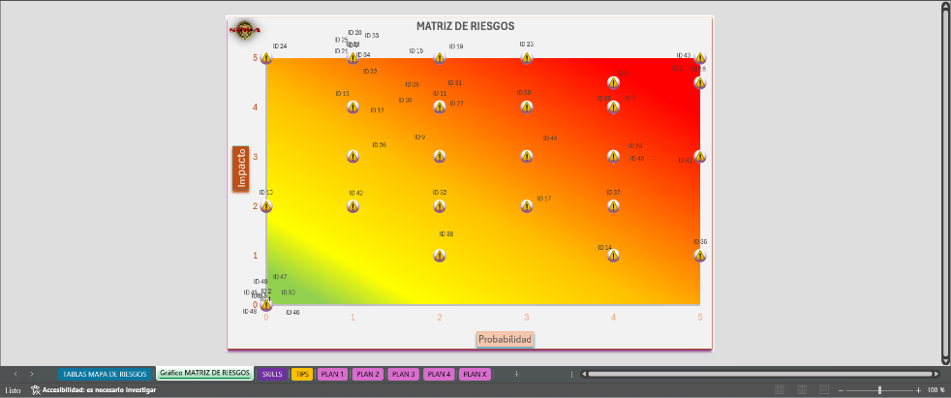
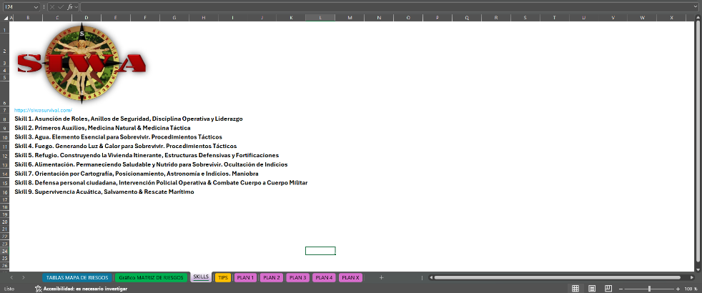
SAMPLE DOWNLOADABLE RISK MAP (XLSX)
Link:
Mapa de riesgos SIWA Start Instructor (1).xlsx
* Content supervised by the SIWA Start Course Director (SSCD)

Slide 46

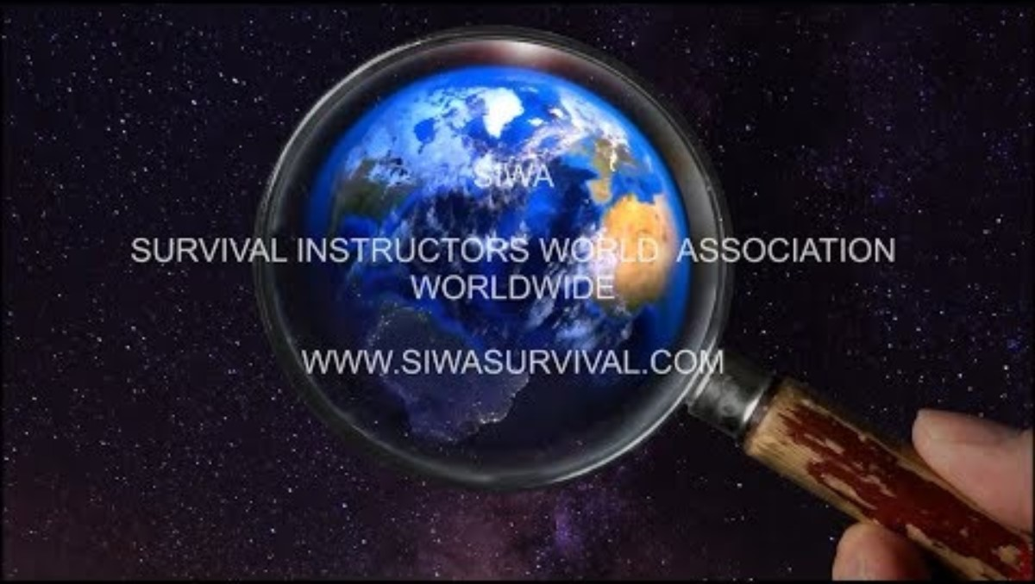
DO YOU HAVE ANY QUESTIONS?
siwacertifications@gmail.com
WhatsApp +34 677 576 328
https://siwasurvival.com/
https://www.facebook.com/groups/survivalwithsiwa/
http://www.youtube.com/@siwasurvivalinstructorsworldas
SIWA and its World Associations
are registered in
LLC LI 7000015171
State of Florida at Tallahassee
Survival Instructors World Associations Company

